Slide 1
How to view your COVID-19 Activity in MyChart
Website and Mobile App

Slide 2
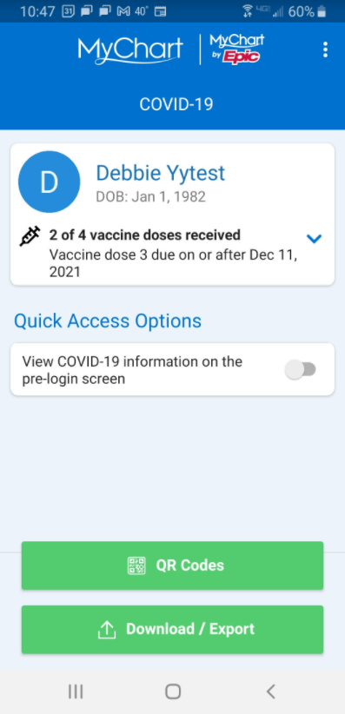
You can now see, and show others, your current COVID-19 vaccination status in MyChart.
See the number of vaccine doses you have been given, including the name, manufacturer, lot number, and location where you received your vaccines.
Generate QR Codes
Download Vaccination PDF
Export your COVID-19 information to another App

Slide 3
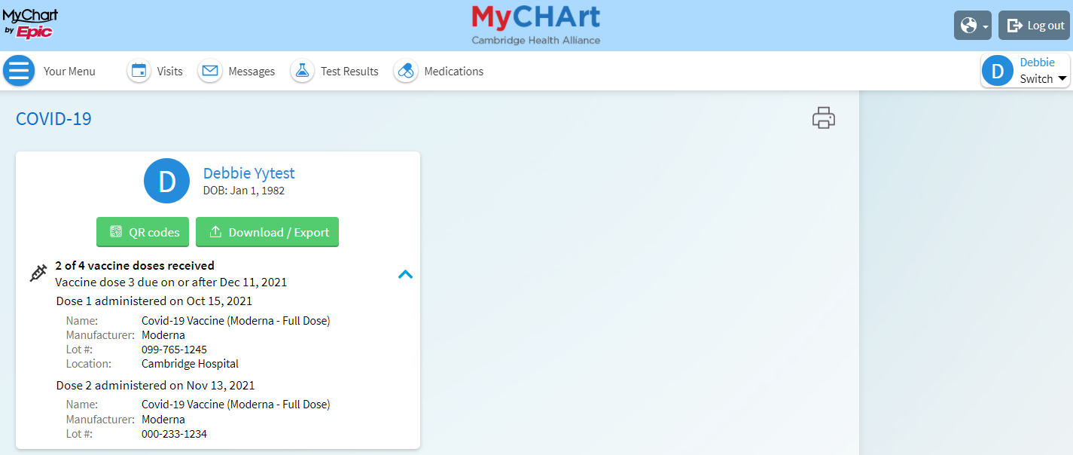
See your COVID-19 activity on the MyChart website by going to “My Record > COVID-19.”

Slide 4
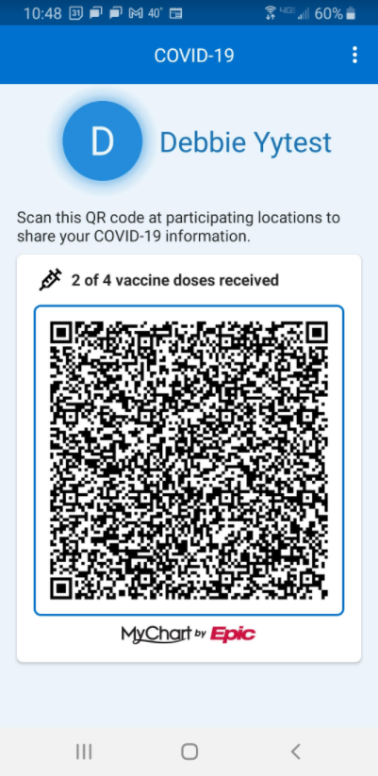
Click the QR Codes button to generate a code with your COVID-19 information
Your QR code can be scanned right from your phone.

Slide 5
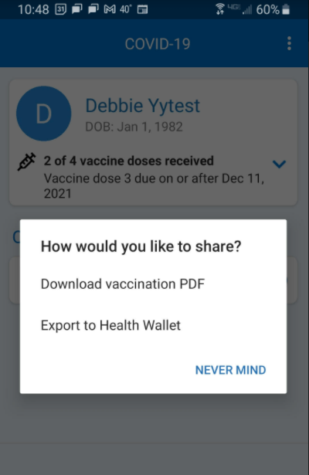
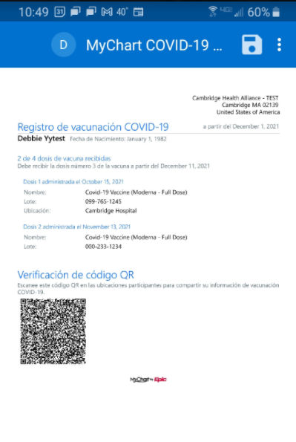
Download a PDF with Your COVID-19 Vaccination Information
You can download a PDF from the website or mobile app onto your computer or mobile device. Spanish translation is available if this is set as your primary language.

Slide 6
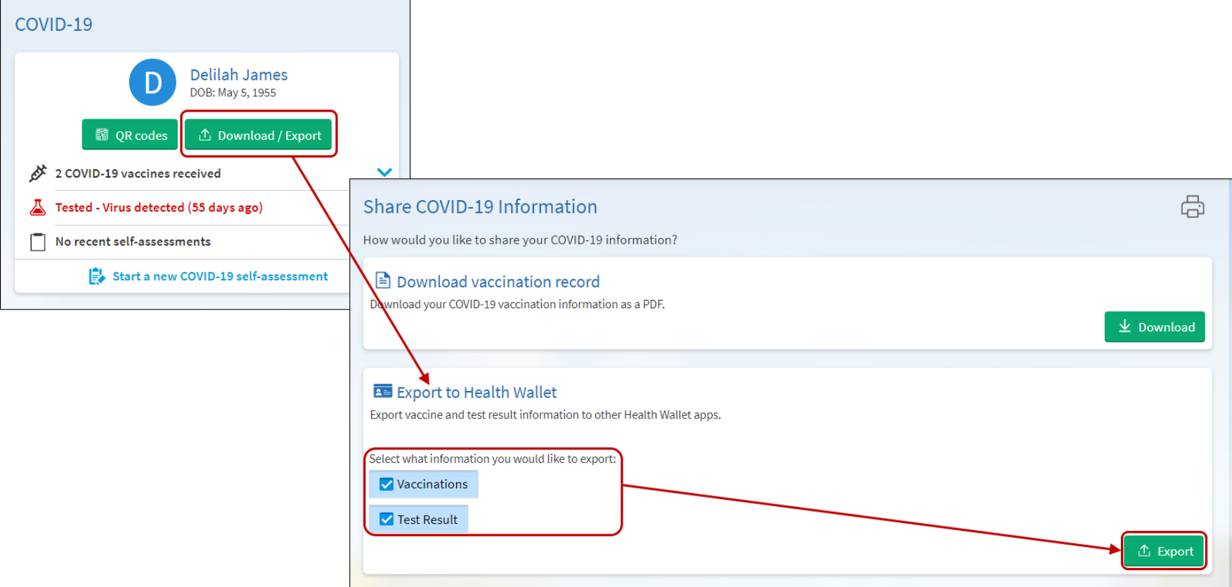
Export COVID-19 Information to Another App
You can export your vaccine and test results to other Health Wallet Apps.

Slide 7
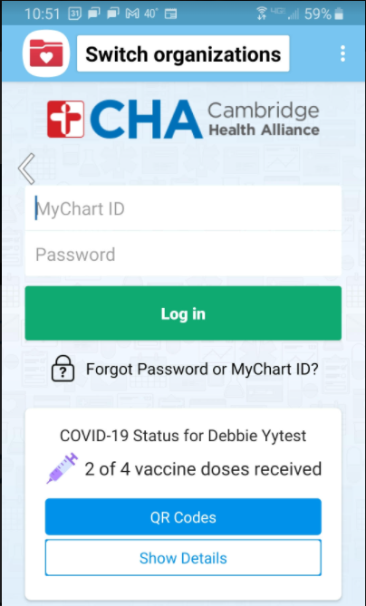
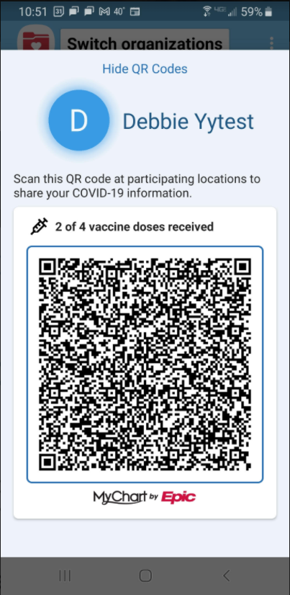
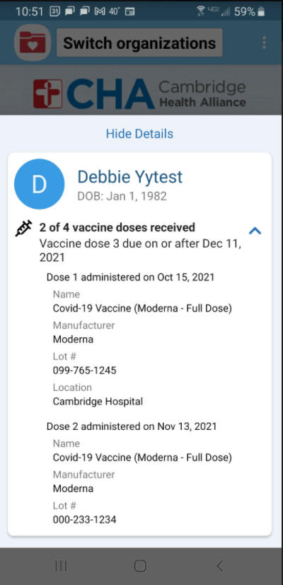
You can also show your COVID-19 vaccination information on the MyChart mobile app without logging in to MyChart.

Slide 8
Videos about these changes
Learn more about these changes by watching the videos linked below:
MyChart website
https://youtu.be/rOQVTuucc54
MyChart mobile app
https://youtu.be/Wlj_xkukNrA

