Slide 1

Diabetes Group
Notes:
Make sure 8th grade reading level, less words (feedback from Maureen)

Slide 2

This class is for you!
Our goal is to help you meet YOUR goals!
We will cover some basics about diabetes.
More importantly, tell us what you want to talk about!
Ask us your questions during the slides, or write them down and ask at the end.
If you are not comfortable asking questions or sharing, that’s ok! You can always email us or your care team later.

Slide 3
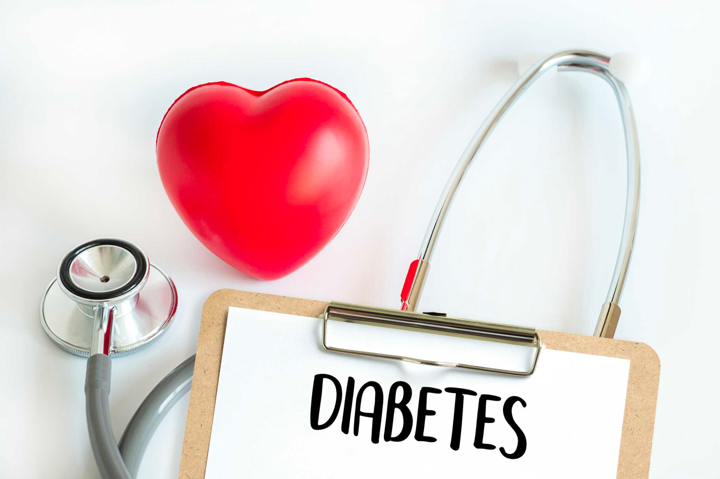
What is diabetes?
Diabetes is a chronic (long-lasting) health condition that affects how your body turns food into energy.
Your body breaks down food into sugar and releases it into your bloodstream.
You need some sugar for everything you do - like walking, talking, thinking, and using your muscles.
In diabetes, the amount of sugar in your blood is too high (hyperglycemia).
Notes:
Chronic = long-lasting

Slide 4
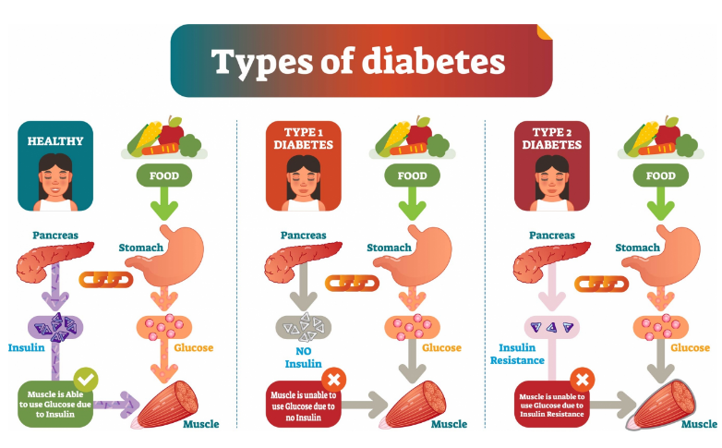
NO DIABETES
https://www.hhs.nd.gov/public-health-information/diseases-conditions-and-immunization/north-dakota-diabetes-prevention-2-1
Notes:
There are several different types of diabetes.
Typically, in people without diabetes, the food you eat enters the stomach and get turned into sugar, or glucose. Your pancreas makes insulin, a hormone, that moves that sugar into your muscles. When sugar is in your muscles, you can use it for energy.
In type 1 diabetes, your pancreas does not make any insulin at all. The sugar is then trapped in the blood. It’s very sticky and clogs things up causing complications. We’ll talk a bit more about those later.
In type 2 diabetes, your pancreas does make some insulin. However, it makes less and less every day. Once it gets to the muscles, it has a hard time letting the sugar in. That’s called insulin resistance. So even though the insulin is there, the sugar is still trapped in the blood.
There are other types of diabetes, too, but these are the most common.

Slide 5

Diabetes as Pizza

Slide 6
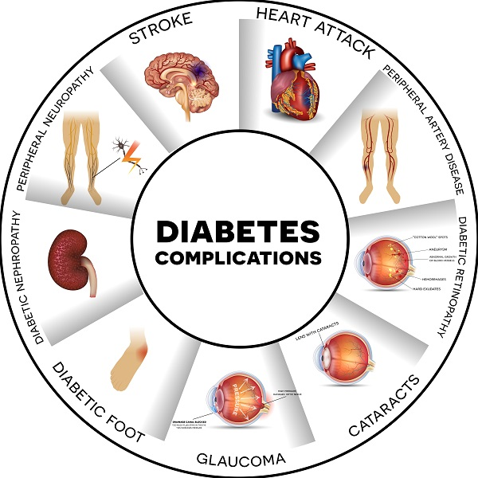
Why do we care about treating diabetes?
Over time, high blood sugar can cause:
Heart and blood vessel disease
Eye damage: like vision changes or blindness
Kidney damage
Nerve damage: like pain or numbness in the hands and feet. This is also called neuropathy.
How?
High blood sugar damages the blood vessels that supply blood to vital organs
Over time, high blood sugar can damage blood vessels and vital organs.
Complications include heart disease, blindness, kidney disease, and more.
The good news is that lowering blood sugar lowers your risk!
Notes:
Why do we care about treating diabetes? Researchers have studied thousands and thousands of patients with diabetes. What they’ve found is that people with high sugar levels are more likely to have kidney problems, heart attacks, stroke, vision problems, and problems with the nerves in their feet which causes pain or numbness. Lowering the sugar lowers the risk of these complications. So how do we actually do that? The number one thing is with diet and exercise.

Slide 7
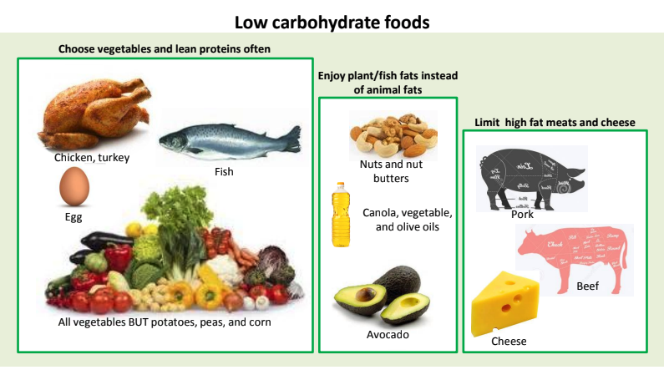
Notes:
Let’s start with food. The foods shown here are low in carbohydrates. Carbohydrates are the foods that our body turns into sugar. Because these foods are low in carbohydrates, you can eat larger portions without spiking the sugar too much. Things like meats, fish, eggs, vegetables (except potatoes, peas, and corn), nuts, avocados, cheese.
Next, I’ll show the foods that are higher in carbohydrates. They are ‘NOT BAD FOR YOU’ but it is important not to eat too much of them.

Slide 8
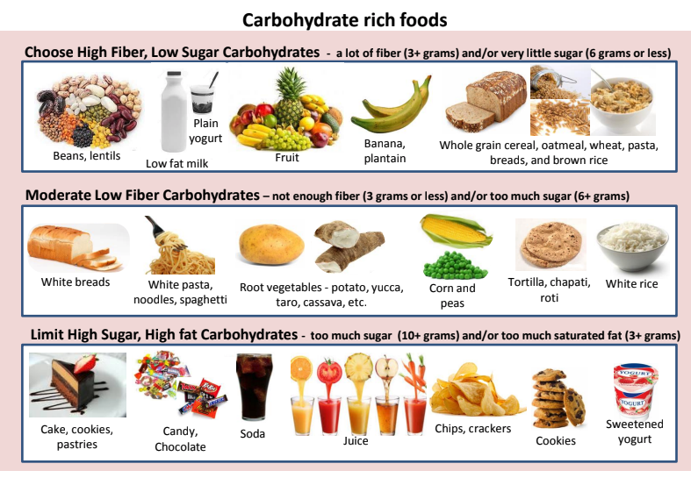
Notes:
These are the foods that your body easily turns into sugar. They still have vitamins and nutrients, and you can absolutely continue to eat them. However, think about your meals. Are they usually rice and beans and fruits and tortilla or chapati? Try to think about ways you can replace some of those foods with vegetables and lean meats. That way your plate will be more balanced.

Slide 9
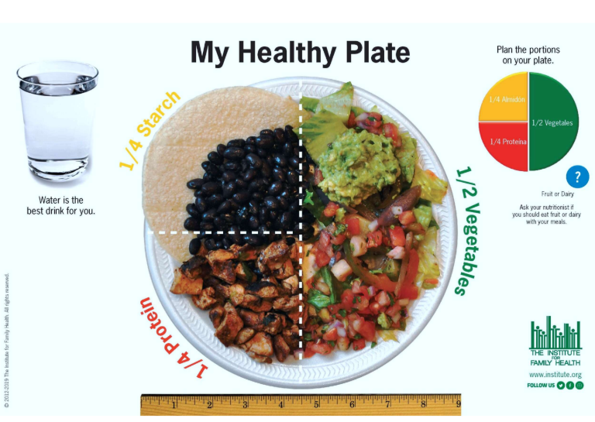
DO:
Eat small meals and healthy snacks every 3-4 hours
Choose foods rich in nutrients and whole grains
AVOID:
Crash dieting
Fasting (speak with your care team if you fast for religious reasons)
No-carb diets
Notes:
This is one example of how to balance your plate. First, add your vegetables. Can you get them to cover half the plate? They can be salad, they can be grilled, they can be stir-fry, they can be frozen or fresh. It doesn’t matter. Next, add some healthy proteins like chicken, fish, tofu, even red meat is low in sugar. Finish off with your carbohydrates. It could be a portion of pasta, bread, rice, fruit, whatever is your favorite.

Slide 10

Exercise
Exercise can help:
Lower A1c
Decrease insulin resistance
Weight loss
Lower blood pressure
Lower cholesterol
Notes:
Exercise also helps lower the sugar, helps your body’s own insulin work better, helps lower blood pressure and cholesterol, and of course helps with weight loss, if that is one of your goals. Sometimes people also need medications to lower the sugar. I’m going to talk about the more common ones now.

Slide 11
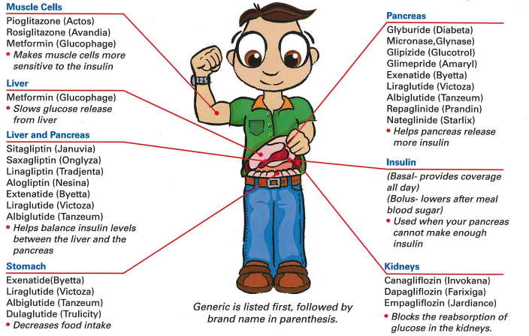
Metformin
Works by decreasing glucose production in the liver
Decreases A1c by 1.5% to 2%
No weight gain or hypoglycemia
Potential heart benefit
Inexpensive and well tolerated
Notes:
First, we have metformin. Metformin has been around a long time and is pretty inexpensive. It can cause a very small amount of weight loss and doesn’t cause low sugars. For people who don’t have side effects with it, we usually start with this first. The most common side effects are stomach upset, nausea, constipation, and diarrhea. Taking it with food helps. If you are someone that has side effects with metformin, let your care team know so we can talk about other ways to make you feel better.

Slide 12
SGLT2 Inhibitors
Work by increasing the amount of sugar excreted in urine
Decrease A1c by 0.8%
Helps keep the heart and kidneys healthy
Lower blood pressure a small amount
Examples:
Jardiance (empagliflozin)
Invokana (canagliflozin)
Farxiga (dapagliflozin)
Notes:
Another group of medicines are called SGLT2 inhibitors. These are medicines like Jardiance, Invokana, Farxiga, Synjardy, and Steglatro. They help your body remove extra sugar by helping you pee it out. Because of this, it’s best to take these with a full glass of water so they can do their job. If you don’t drink enough water, or if you’re outside working or exercising on a hot day, you can get dehydrated. If you take one of these medicines, be sure you always drink plenty of water. A good way to tell is by the color of your urine. If it is dark yellow or brown, you need more water. If it is clear (like water), then you are well hydrated. Most of the time, you should also skip these medicines if you get sick for some reason (like food poisoning or getting the flu) and are vomiting or have diarrhea. You can become very dehydrated on those days, so it’s best to avoid this pill. You can start it again when you feel better.

Slide 13
GLP-1 Agonists
Work by slowing down food in the stomach, helping your body make its own insulin, and stopping the liver from making extra sugar
Decrease A1c by 1.5% or more
Help protect the heart and kidneys
Cause weight loss
Examples
Trulicity (dulaglutide)
Ozempic (semaglutide)
Victoza (liraglutide)
Notes:
Another very common group of medicines right now are the GLP-1 agonists. These are injectable medicines, although they are NOT insulin. They work in a few different places. They help your body make it’s own insulin, help stop your body from making extra sugar it doesn’t need, and they work to help you feel full when you eat. They do this by slowing the food moving through your stomach and by helping your brain recognize when you are full. Most of the side effects are stomach related - like feeling nauseous, diarrhea, and constipation. However, these side effects usually only happen when you are first starting or changing the dose. After you’ve taken the medicine 2 or 3 times, they usually go away on their own. These are particularly helpful if you have a goal of weight loss.

Slide 14
Insulin
Long-acting (basal)
Lasts up to 24 hours
Usually injected once per day
Lowers fasting blood sugars
Meal-time insulin (bolus)
Lasts 2 or 3 hours
Injected before each meal
Lowers sugar after food
Notes:
Insulin has been around a very long time, we’ve actually been using it for more than one hundred years! There are two main types. Usually they are called long-acting and short-acting insulin. Sometimes you may hear people call them basal (that’s the long-acting) and bolus (that’s the short-acting). All insulin is a copy of what your body makes on it’s own, with some changes to help make it last longer in the body. People can inject insulin once per day, sometimes up to 5 or 6 times per day. Some people use it continuously as part of an insulin pump. Whatever way you use insulin, it always works to lower the sugar. It can also cause weight gain, so it’s important to stick to your food and exercise plan. Doses of insulin usually need to be adjusted to find what works for you.

Slide 15
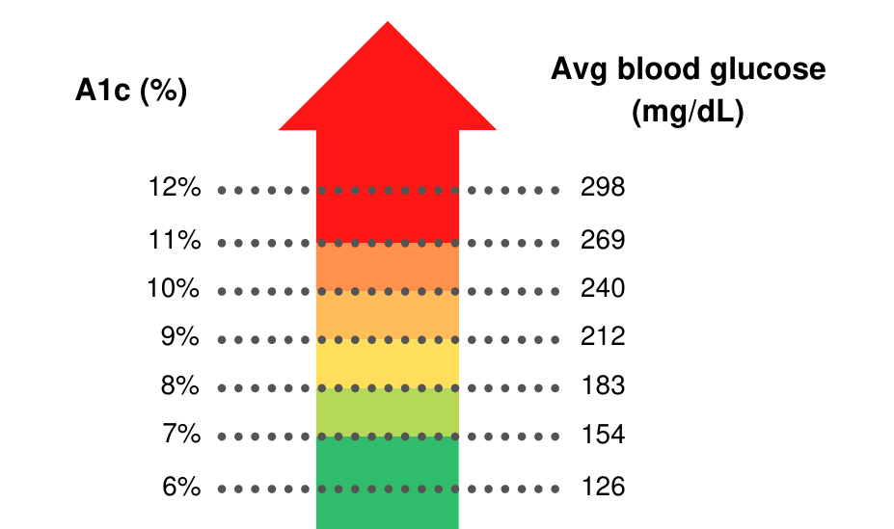
Tracking Diabetes
What is an A1c?
A1c, or hemoglobin A1c, is an average of your blood sugar for the past 3 months.
A1c is a percentage.
An A1c over 7% means that the risk of complications is higher.
Notes:
That brings me to:
How do keep track of your sugar levels? There are two ways. The first way is a measurement we check in the clinic. It is called A1c or hemoglobin A1c. It shows your average sugar for the past 3 months.
It measures what percentage of your blood cells have sugar attached.
It also helps predict your risk of complications. In all the diabetes research that has been done, and we’re talking about thousands of patients, people who had an A1c below 7% were much less likely to have diabetes complications.
That’s why we check the A1c and help you work on ways to bring it down.

Slide 16
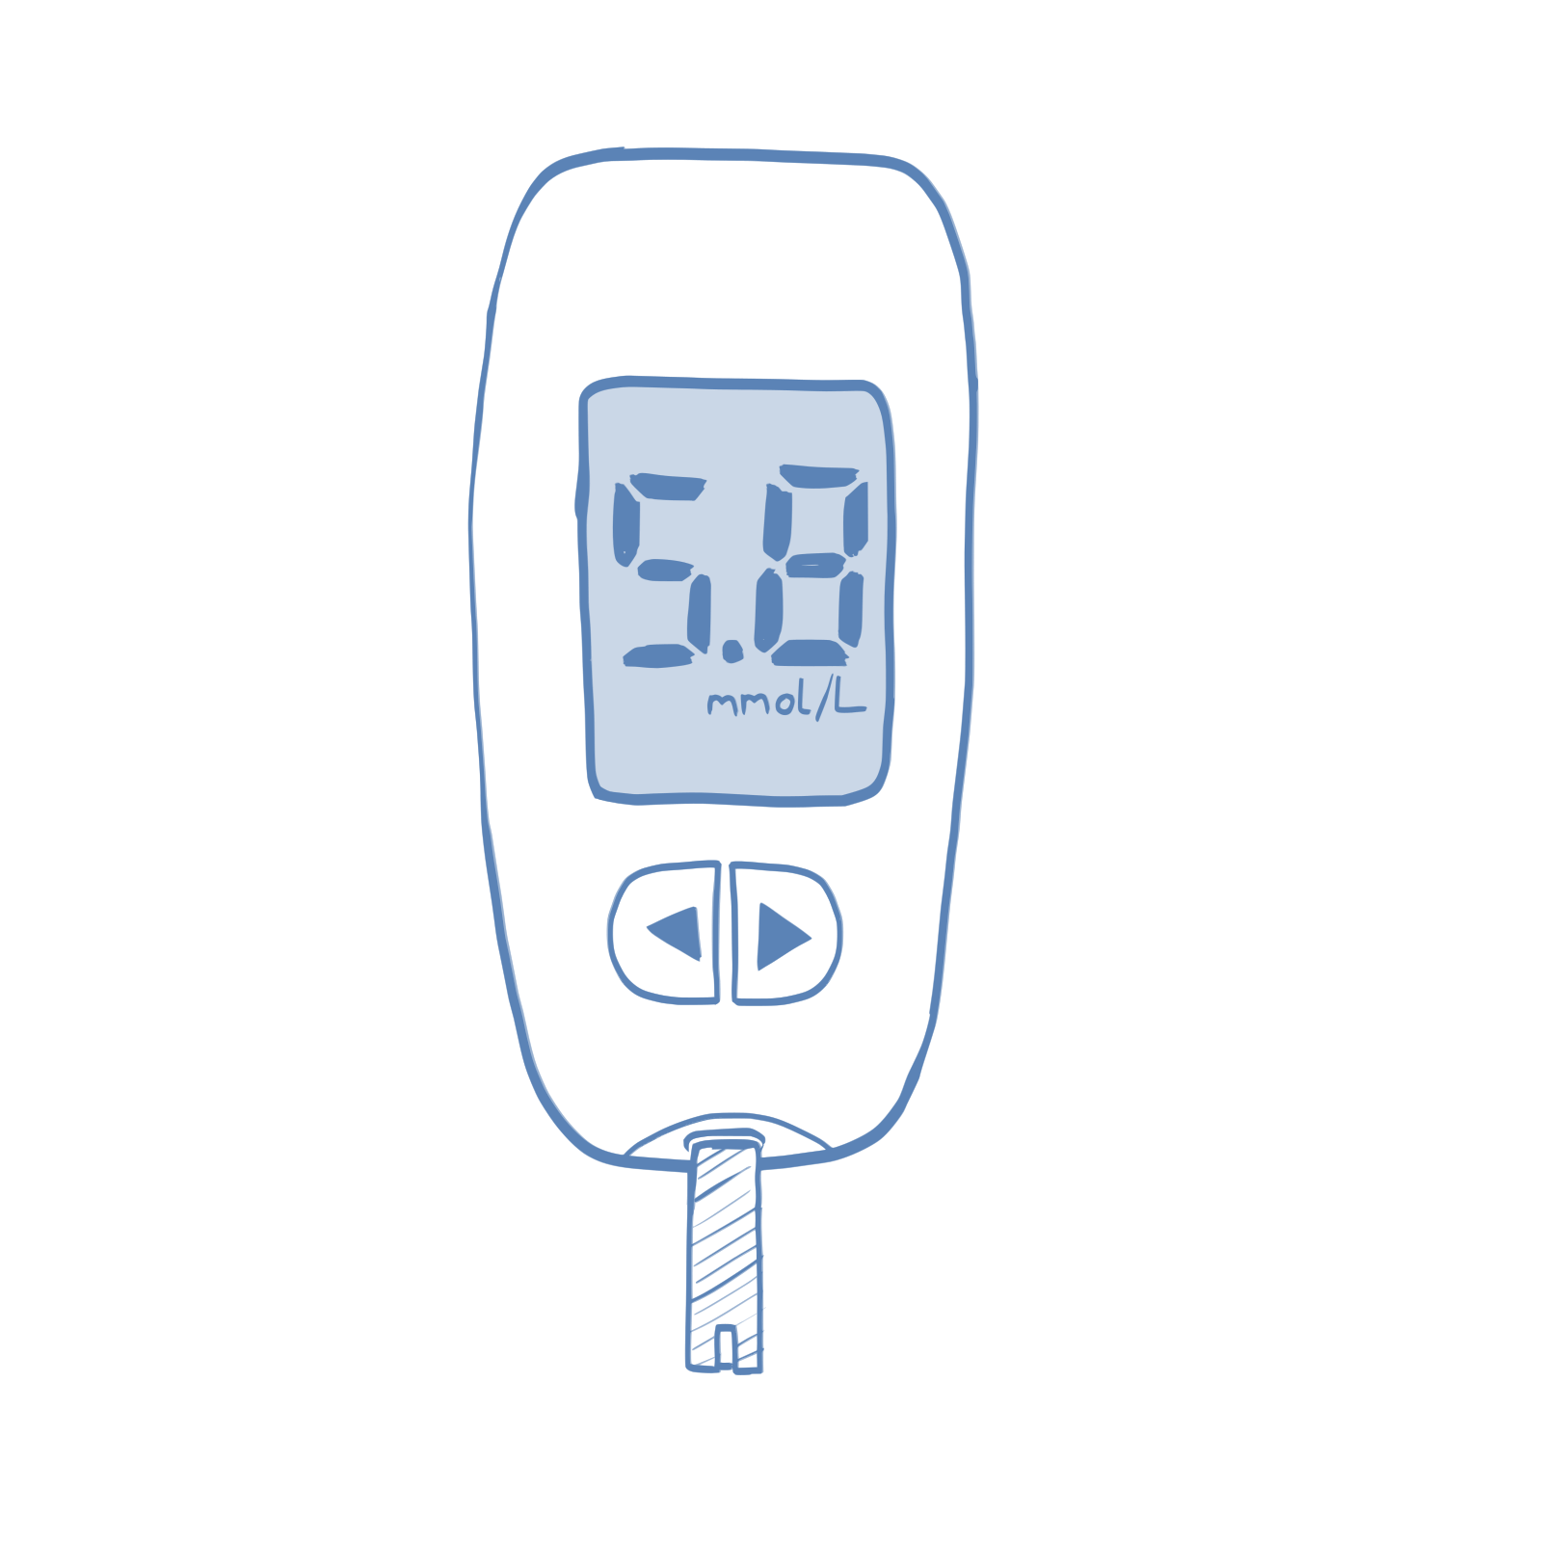
Fingerstick Blood Glucose Monitoring
Blood sugar, or blood glucose, is a measure of the amount of sugar in your blood at one time.
It only shows your sugar at the time you test.
Make a plan with your care team about how many times to test your sugar per day.
Keep a written log of blood sugar readings between your appointments. These numbers are very important to help find the right medicine doses.
Notes:
The second way we measure blood sugar is by looking directly at the sugar in your blood. Some people use fingerstick machines, or glucometers, to test the blood. Some people use continuous glucose monitors, which I’ll talk about on the next slide.
Glucometers, or fingerstick machines only show the sugar at one moment in time. That is, they only show the sugar exactly when you test. It doesn’t show your sugar 5 minutes ago, or 5 days ago.
That’s why it’s so important to keep a log of these sugars. Only knowing your sugar at one moment, isn’t particularly helpful. But if we look at the trend and overall picture over several weeks or months, it helps us see more clearly.
It is so helpful when people bring in their machines or log book to visits.

Slide 17
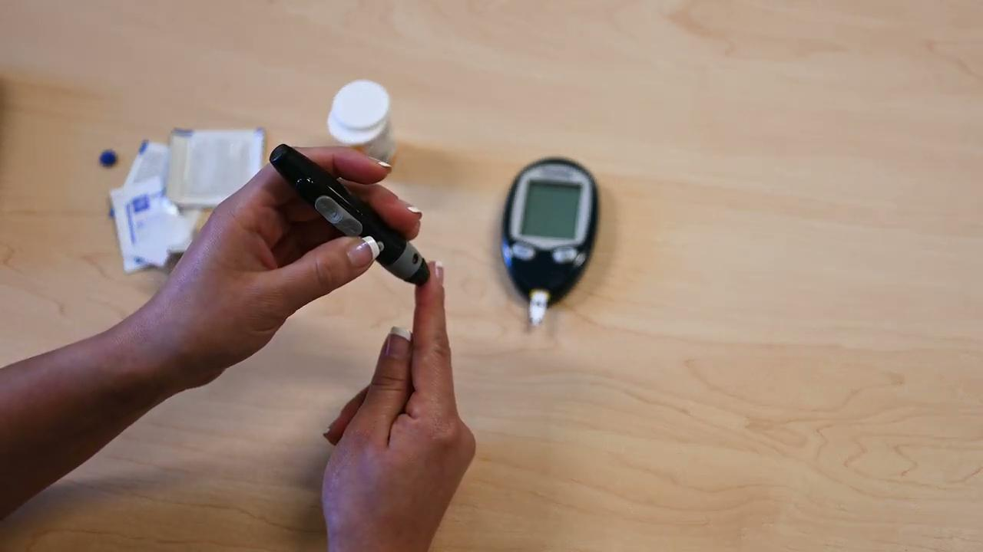
How to Test Your Blood Sugars
Notes:
Note: make own video
This is just one type of glucometer…

Slide 18
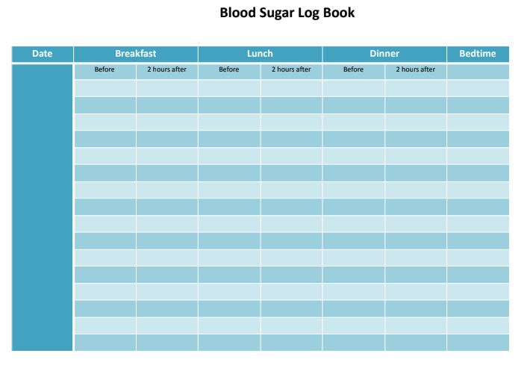
Notes:
Here is an example of a blood sugar log book. You can use something like this, or just write the numbers down on any piece of paper you have lying around.

Slide 19
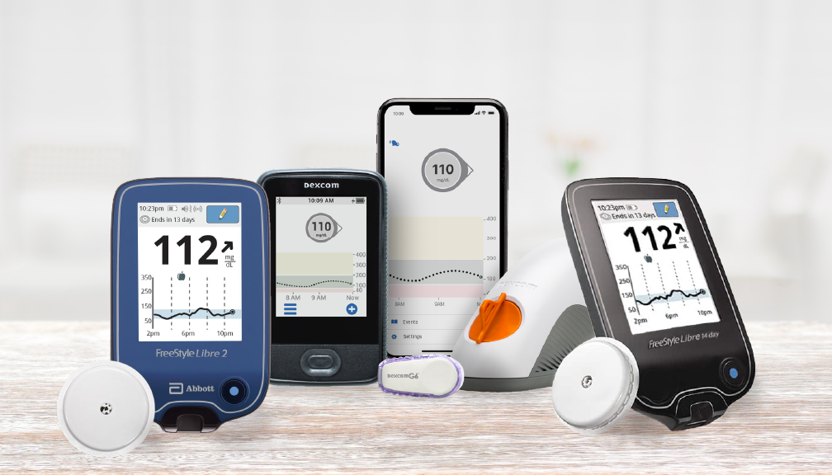
Continuous Glucose Monitoring
Some people use continuous glucose monitors, or CGMs, to measure sugar.
These devices can connect with smartphones.
They measure the sugar all the time.
Some insurances may only cover the cost of these in certain situations. Check with your care team to find out if you are eligible.

Slide 20
Common Blood Sugar Targets
Fasting Blood Glucose (Before breakfast) | 80-130 mg/dl
Postprandial Glucose (2 hours after a meal) | 80- 180 mg/dl
Some people may have different goals. Ask your care team about the best goal for you.
Notes:
Whether you are looking at your sugars using a fingerstick glucometer or a CGM to look at your sugar, these are some general blood sugar targets that we use. For most people, we set a goal of 80 - 130 for morning sugars. That means before eating or drinking anything that day. If you check 2 hours after eating, we look for readings below 180. Again, these are general targets that may be modified based on age, whether you’re pregnant, if you have lots of low sugars, or other factors.

Slide 21
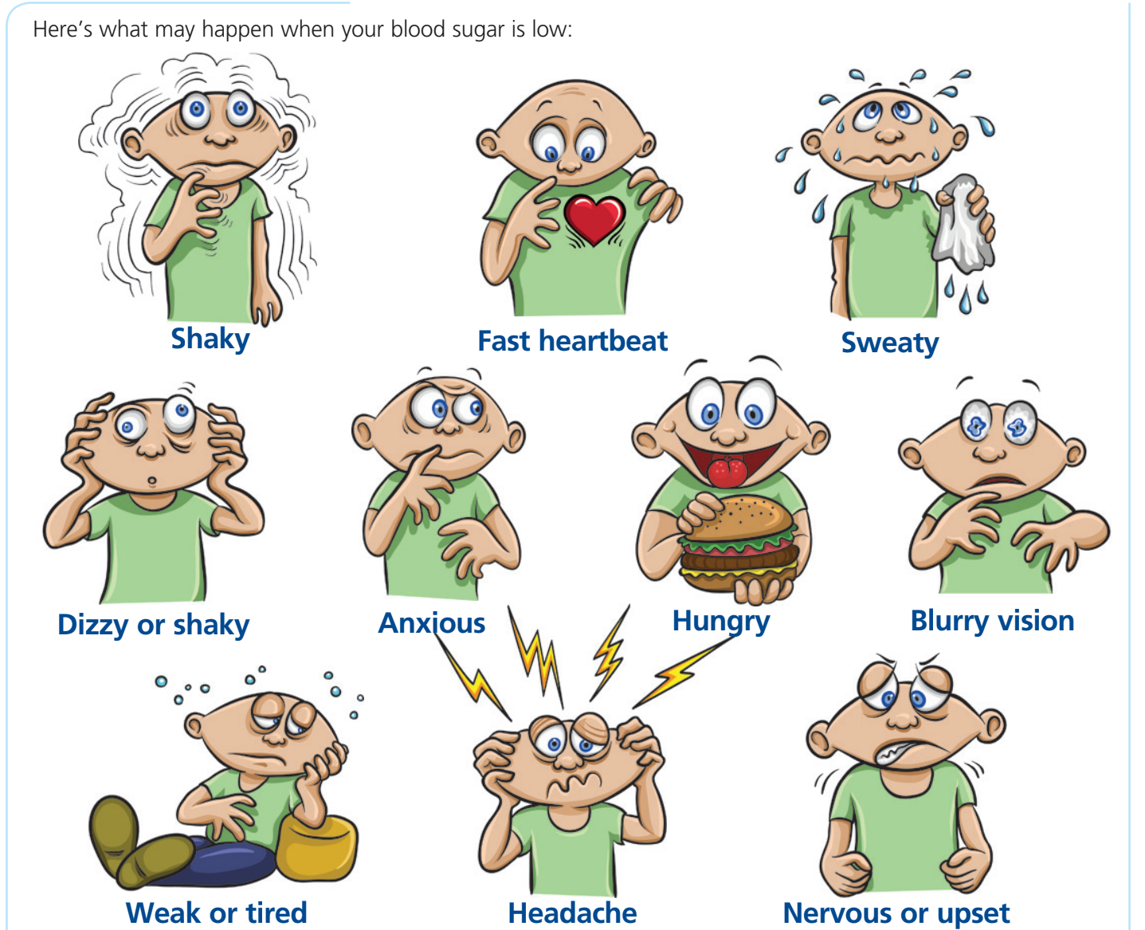
Low Blood Sugar
Low blood sugar is also called hypoglycemia.
Blood sugar is too low if it is below 70 mg/dL.
You may feel sweaty, dizzy, tired, hungry, shaky, or upset.
Notes:
If your sugar is below range, we call that hypoglycemia. Sometimes people don’t feel any differently when their sugar is low. However, people commonly have symptoms like feeling shaky, sweating, heart racing, and feeling hungry. We want to keep sugars above 70 so that this doesn’t happen to you. Low sugars can happen for a lot of reasons, like missing a meal, exercising and forgetting to eat afterwards, or accidentally taking more medication than prescribed for diabetes.

Slide 22
How to Handle Low Blood Sugars
Remember the Rule of 15 if you have a blood sugar reading below 70.
Eat or drink 15 grams of carbs. Some examples are:
  ½ cup of juice or 1 cup of milk
  1 tablespoonful of honey
  3-4 glucose tablets
Recheck your blood sugar in 15 minutes
Repeat steps 1 and 2 until your blood sugar is above 70 mg/dL
Notes:
If a low blood sugar does happen, here are some tips to bring it back up. I like to use the Rule of 15. Basically, you eat or drink 15 grams of carbohydrates. There are some examples here, like ½ a cup of juice or milk, 3-4 glucose tablets, or even a handful of small candies. Recheck your sugar in 15 minutes. You can keep doing this until the sugar is in range again above 70.

Slide 23
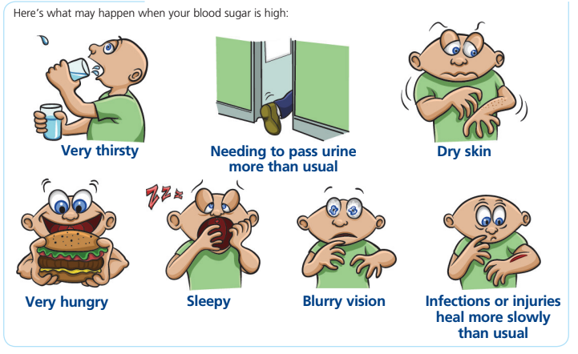
High Blood Sugar
High blood sugar is also called hyperglycemia.
When your blood sugar is high, you may feel sleepy, very thirsty, hungry, or as if you need to throw up. You may also have blurry vision or need to pee more.
Sometimes, you may not feel any differently when your blood sugar is high. This is why it’s important to test sugar at home.
Notes:
High blood sugar can also have symptoms, like feeling thirsty, needing to use the bathroom more often, feeling tired, and vision changes. Unfortunately though, most people don’t feel any differently when the sugar is high. That’s why it’s important to regularly check the sugar.

Slide 24
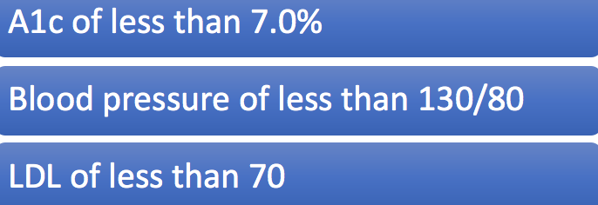
General Targets for Diabetes
Targets are patient specific and are dependent on many different factors. Check with your care team to find the best target for you!
Notes:
When you come in for your diabetes appointments, we will also keep an eye on other targets to help keep your heart and kidneys healthy. We will check your blood pressure and generally aim for a goal of below 130/80. We will check your cholesterol with a goal of below 70. Again, these are general goals and may be different from person to person.

Slide 25
Your Care Team will help you monitor diabetes!
A1c check every 3 months
Diabetes foot and eye exams every year
Lipid panels (cholesterol check) every year or after starting cholesterol medicine
Urine protein tests every year
Vaccines (Hepatitis B, pneumonia, flu shots)
Flu shot, foot and eye exam, urine protein and A1c
A1c
A1c
A1c
3 months
6 months
9 months
1 year
Notes:
Here is a summary of the regular things your care team will be monitoring.

Slide 26
Questions?

Slide 27
References
American Diabetes Association Professional Practice Committee. 2. Classification and Diagnosis of Diabetes: Standards of Medical Care in Diabetes-2022. Diabetes Care. 2022 Jan 1;45(Suppl 1):S17-S38.
Centers for Disease Control and Prevention. (2022) Family Health and Diabetes. Retrieved from https://www.cdc.gov/diabetes/basics/type2.html
Arnett DK, Blumenthal RS, Albert MA, et al. 2019 ACC/AHA Guideline on the Primary Prevention of Cardiovascular Disease: A Report of the American College of Cardiology/American Heart Association Task Force on Clinical Practice Guidelines. Circulation. 2019 Sep 10;140(11):e596-e646

