Slide 1
CHA Covid-19 Response Continuum of Care Strategy
Goal: Save as many lives and life-years as possible
4.6.20

Slide 2
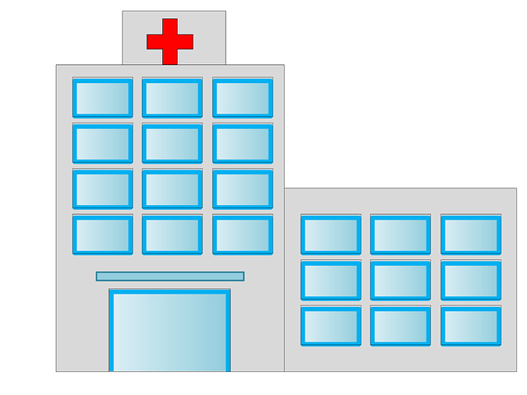
COVID-19
Care
Essential Medical
Care

Slide 3
CHA Objectives:
Identify individuals infected with COVID-19 and provide optimal support for care in the community, including support for isolation and quarantine of positive individuals
Provide inpatient and intensive care services to a maximal number of COVID-19 infected patients who need and can benefit from those services
Continue non-COVID related critical clinical services to the community
Steward, protect, and support staff resources effectively for management of the pandemic over the duration of the pandemic
Steward supplies effectively for the management of the pandemic over the duration of the pandemic
Ensure effective internal and external communication

Slide 4
Community Goals: Prevent as many Covid-19 cases as possible Prevent incident disease requiring ED or Acute Care
Prevention
Action
Prevention
Social media & CHA websites
Primary Care:
Outreach calls to 30,000 higher risk CHA patients
Toolkit developed & deployed for MA, PMR & other staff to place proactive education and screening calls
Action
Primary Care:
Newborn in person care
Deliver childhood essential vaccinations age 2 – 15 months
COVID-19 Strategy
Prevention
Broad Community Education
Individual outreach to high risk patients
Essential Medical Care Strategy
1. Prevention

Slide 5
Patients & Families Goals: Identify & support as many Covid-19 cases as possible Prevent incident disease requiring ED or Acute Care
Screening
Counseling
COVID-19 Strategy
Screening & Counseling
Individual outreach to high risk patients
Essential Medical Care Strategy
1. Screening & Counseling
Action
Screening & Counseling
Occupational Health managing employees & first responders
Primary Care:
Smartphrase screening for Covid-19 symptoms
Guidance on escalating care for symptoms
Advance Care Planning by televisit guidance
Action
Primary Care:
Check for medication refills for chronic disease
Offer behavioral health and addiction support
Set up chronic care televisits with providers

Slide 6
Outpatient Testing
Goals: Identify & support as many Covid-19 cases as possible
Steward resources & supplies effectively
Testing
Action
Testing
Drive through testing site, capacity 120/day
Mobile Integrated Health Testing
Primary Care:
Develop and educate on testing algorithms and placing test orders.
Covid Triage Center for patient education and appropriate disposition for patients with symptoms.
COVID-19 Strategy
Testing
Appropriate Covid-19 testing

Slide 7
Remote Care Advice Goals: Support as many Covid-19 cases as possible Steward resources & supplies effectively
Diagnosis
Action
Diagnosis
Occupational Health managing employees & first responders
Primary Care:
Results management from all testing sources including post-ED and Inpatient discharge.
Homecare advice given for children and adults
COVID-19 Strategy
Diagnosis
Individualize advice

Slide 8
Disease Management Goals: Support as many Covid-19 cases as possible Steward resources & supplies effectively Continue non-Covid critical services
Management
Action
Primary Care:
Develop and implement community management handbook with longitudinal management of cases by risk stratification
Respiratory Clinic for in-person evaluation and treatment of outpatient Covid cases and non-Covid respiratory symptoms
Provider on-call guidance
Action
Primary Care:
Complete implementation of Televisits
Escalation to necessary in-person visits at East and Revere
Essential Prenatal Care
Essential chronic care injection management
COVID-19 Strategy
Management
Risk Stratified Covid management
Essential Medical Care Strategy
1. Chronic disease & behavioral health essential care

Slide 9
Emergency Care
Goals: Support as many Covid-19 cases as possible Steward resources & supplies effectively
Escalation
COVID-19 Strategy
Escalation
Pathways for care in disease progression
Action
Community Paramedics
Emergency Department enhanced operations
Primary Care:
Clear communication with community paramedics and hospitals about local and regional availability of acute care resources

Slide 10
Acute Care Goals: Provide inpatient and intensive care services to a maximal number of COVID-19 infected patients who need and can benefit from those services Steward resources & supplies effectively
Escalation
COVID-19 Strategy
Escalation
Expand acute care capacity
Action
Escalation
Covid Care inpatient units
Expanded inpatient, critical care and ICU capacity
Primary Care:
Redeployment of over 200 staff and providers to acute care activities.

Slide 11
Palliative Care
Goals: Support as many Covid-19 cases as possible Steward resources & supplies effectively
Follow up
Action
Follow up
Hospital-based comfort care units
Primary Care:
Provider support for hospice nurses
Televisit and remote support for patient choosing palliative care measures at home
COVID-19 Strategy
Follow up
Palliative and hospice

Slide 12
Continuing Care
Goals: Support as many Covid-19 cases as possible Steward resources & supplies effectively Continue non-Covid critical services
Follow up
Action
Primary Care:
Community management group monitoring moderate and high risk cases until recovery
Behavioral Health support mobilized for patient and family needs.
Action
Specialist e-consults & urgent televisits
Primary Care:
Registry use for chronic disease proactive outreach and management
COVID-19 Strategy
Follow up
Longitudinal monitoring for recovery
Behavioral health support
Essential Medical Care Strategy
1. Chronic disease & behavioral health essential care

Slide 13
Ambulatory Strategy for 5 Phases of Response:
4.6.20
WAVE | CHECKLIST
1: SIGNAL | 1. Televisits Implemented
 | 2. Cancel and postpone non-essential visits
2: SPREAD | 1. Educate on: Social distancing, handwashing
 | 2. Complete virtual care with televisits
 | 3. Skeleton crew for onsite necessary visits
 | 4. Pro-active outreach to vulnerable patients
 | 5. Consistent contact and telehealth management for COVID-19 cases at home a. All phases of disease
3. ACUTE | 1. Continue all Wave 2 activities
 | 2. Protocols & Implementation of triage to testing, in person visit, ED, (admissions), and home care
 | 3. Run outpatient testing and in person visits for COVID-19 symptoms
 | 4. Home management of ill patients. a. COVID-19 community management b. Non-infectious conditions managed at home c. Home hospice
4. CONVALESCENT | 1. Post-hospital discharge patient care at home or in community settings
5. RESILIENCY | 1. Partner with communities on social interventions
 | 2. Screen and manage behavioral health care
 | 3. Address health care worker moral injury & trauma
 | 4. Hold and hardwire advantageous operating gains

